Slide 1
Data Science with Python Career Program - Capstone Project
By- Sakshi Kothavade

Slide 2

Agenda
Data Exploration (Using Excel & Python)
Data insights (Excel & Python)
EDA Graphs
Graphical Analysis and conclusion on Data
Data Cleaning & Pre-Processing Steps
ML Modeling
Model Test Evaulation & Prediction Analysis
Deployment of ML Models using Streamlit

Slide 3
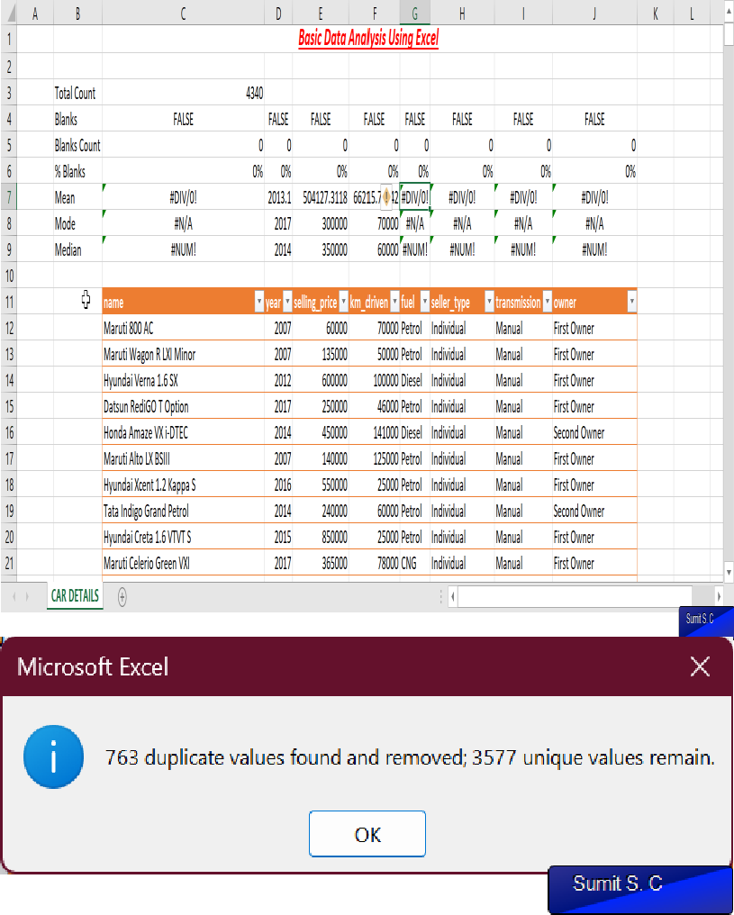
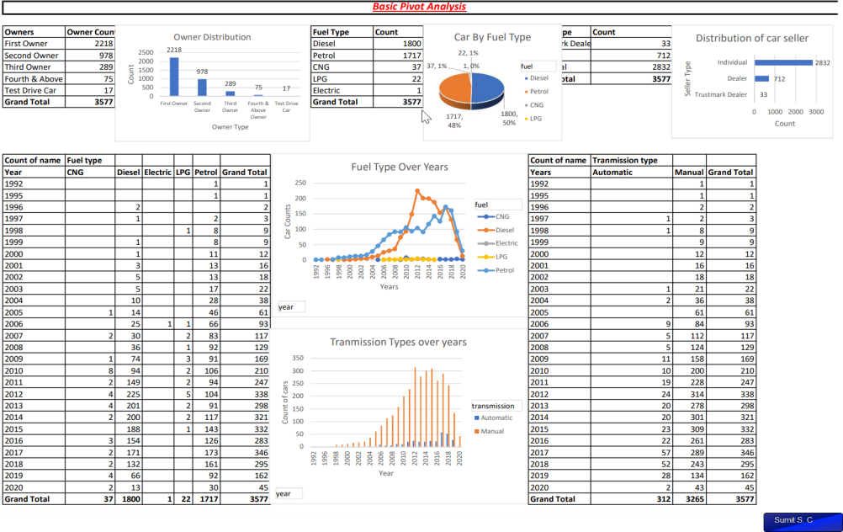
Data Exploration (Using Excel)
Basic Analysis Using Excel Sheet
The Dataset contains 8 rows & 4240 columns showing the information of used cars dataset.
The Basic analysis shows that there is no null value present.
The Analysis further shows that there are 763 duplicate values.

Slide 4
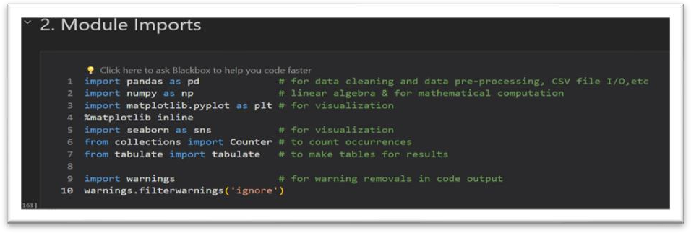
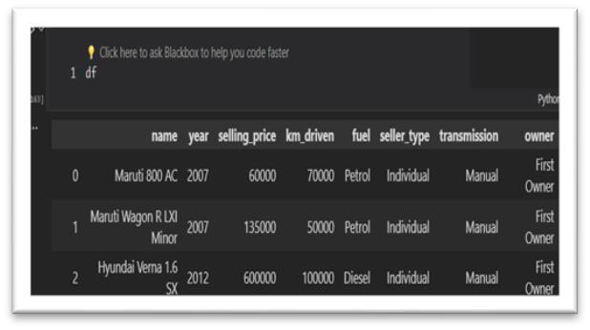
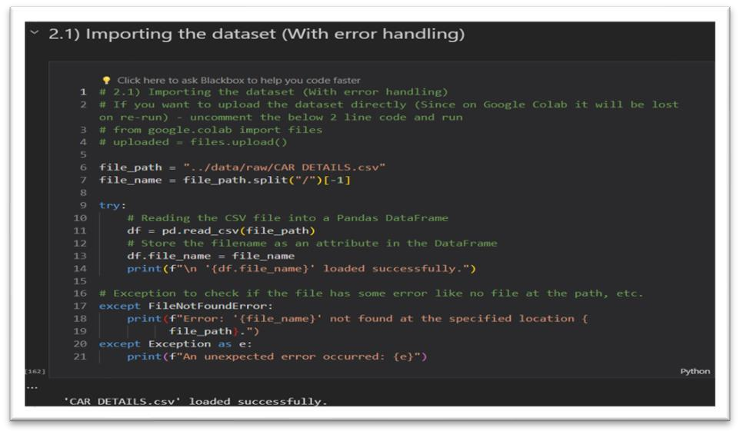
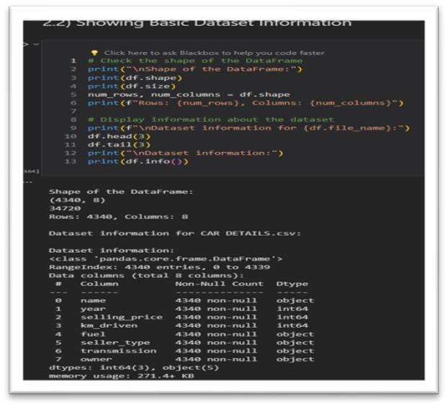
Data Exploration (Using Python)
Step 1–Import Library & Read File
Step 2 – Basic Data Lookup
df – loads the data frame we gave while loading the csv & displays data.
df.shape & df.size
– gives the rows & column info df.head & df.tail – displays 5 values from top & bottom of dataset
df.info – gives the information about the column its datatype and null values.

Slide 5
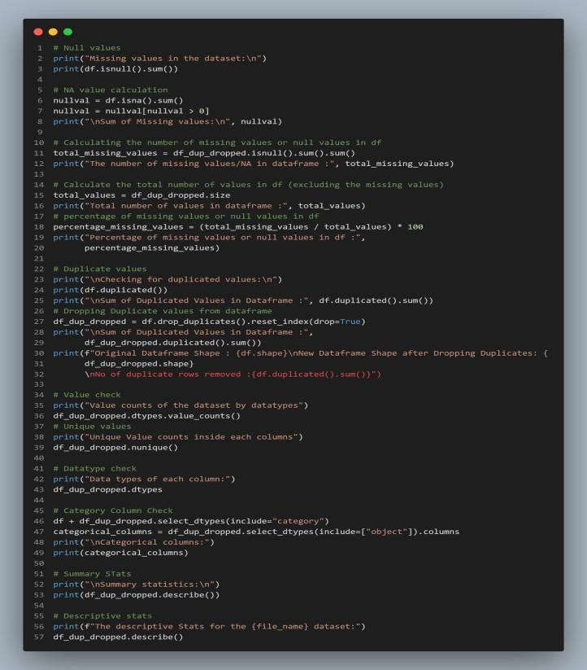
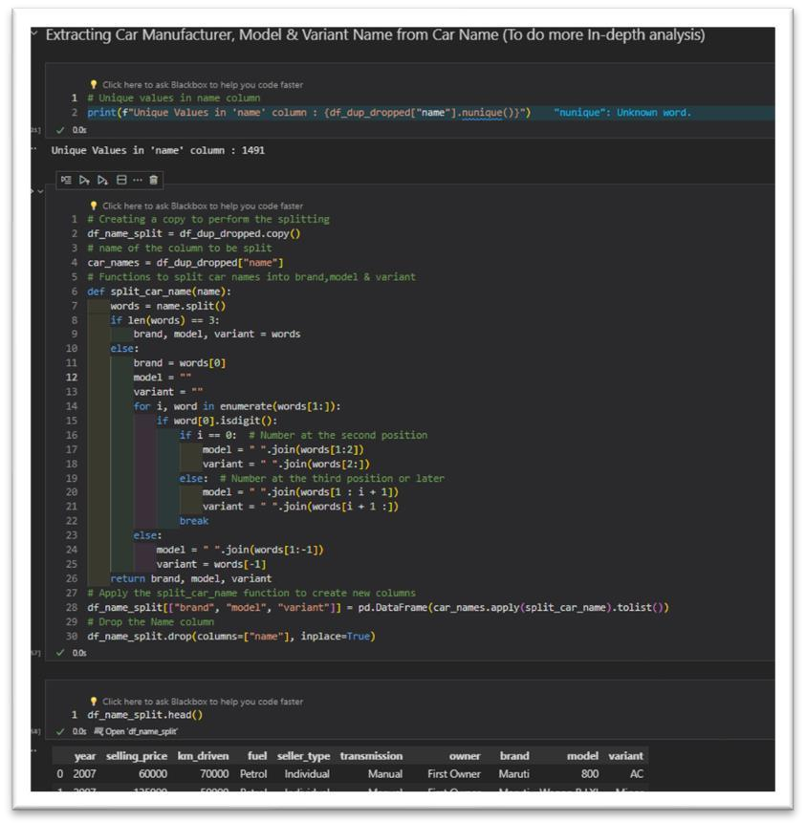
Data Insights (Using Python)
Step 3 –Data Checks
Step 4 –Data Pre-Processing
Step 3 – We do basic checks to find null, duplicates, NA, unique values in dataset.
We also find the categorical columns & statistics to get info about numerical data.
Step 4 – We Pre- process the data and handle the features like splitting name into model, brand, variant to do analysis.
Dropped the name column after split.

Slide 6
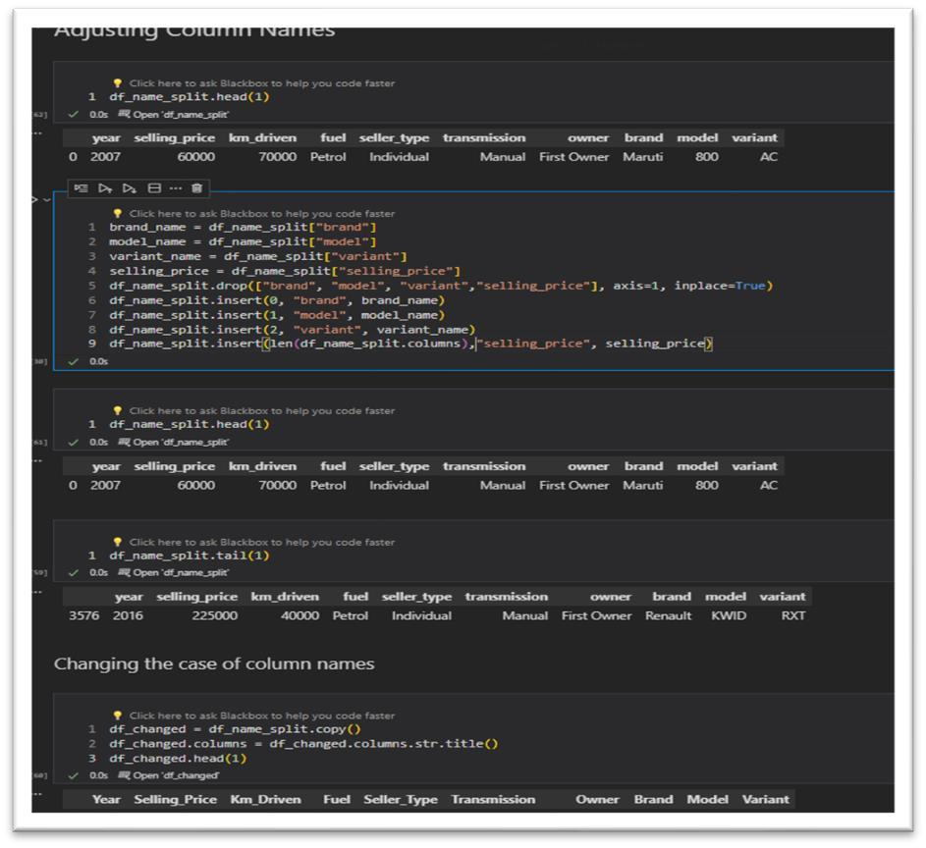
Data Insights (Using Python)
Step 5 –Adjusting Data
Insights :
Data Exploration is very useful step in the process of analytics and model building as it helps us to remove any redundant data & also construct new features to enhance the analysis and model building.
In the data exploration part we eye-ball the data to look at features that help us in analysis and model formation and help us to remove any unnecessary junk from our data.
Most times the data from sources is not cleaned so data cleaning is an important part of the analysis work.
Gathering and exploring data and finding meaningful insights helps us to analyse and train the model more efficiently.
In the step given on the side we adjusted the column names such that the newly added feature at the end are given index value & adjusted likewise selling price being target we move it to end.

Slide 7
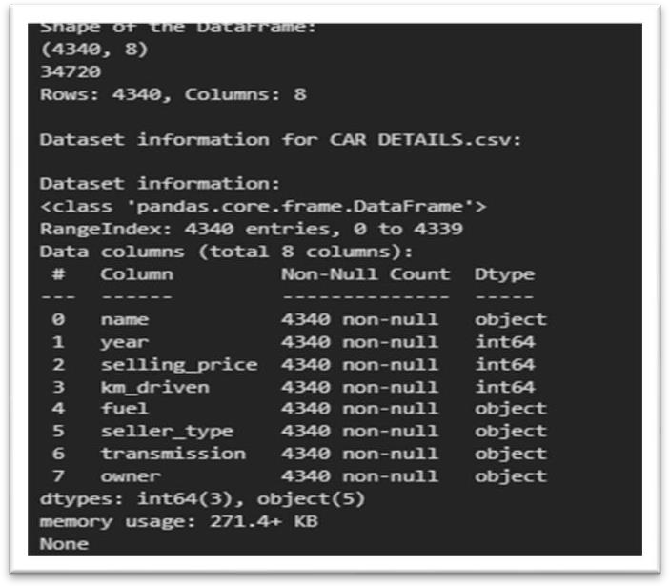
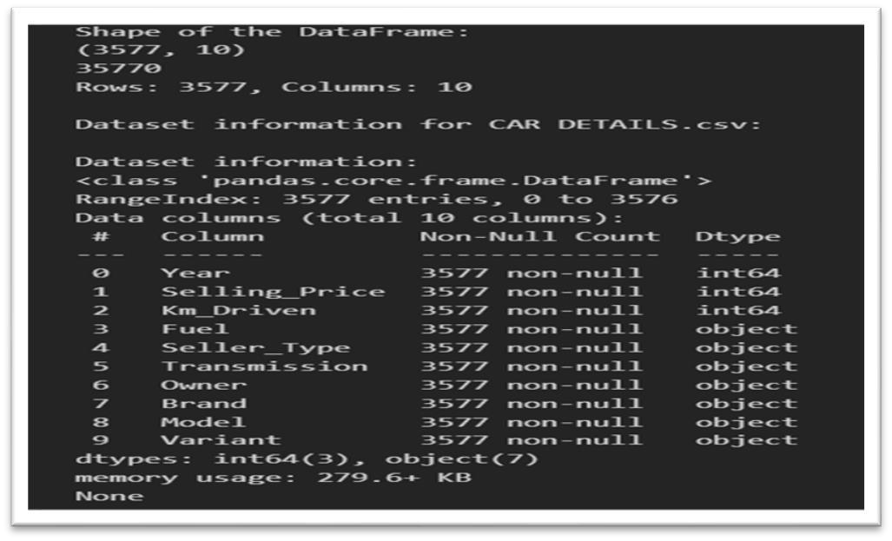
Data insights
Basic Info On Dataset
Dataset after cleaning & adding features
The dataset contains 4340 rows & 8 columns , all are non-null values 3 are numerical while 5 are categorical type.
After cleaning the data , removing duplicates and adding removing features from dataset the new processed dataset contains 3577 rows & 10 columns.3 are numerical while 7 are categorical columns.

Slide 8
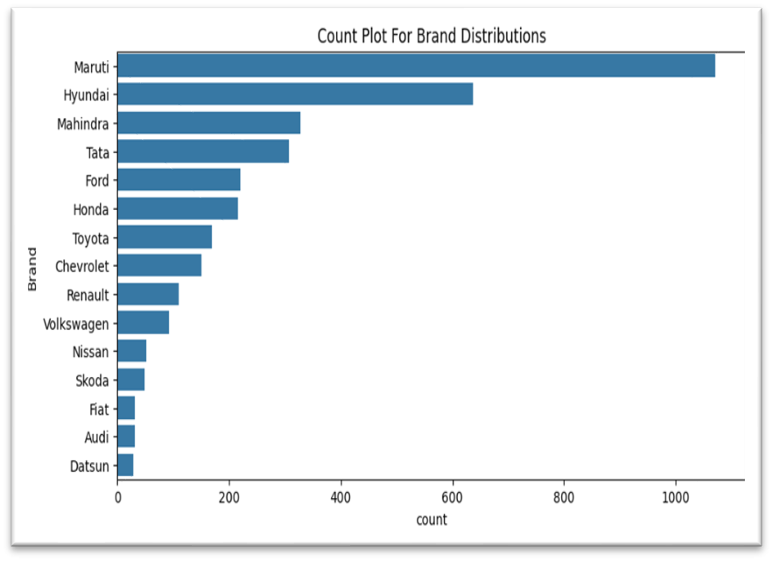
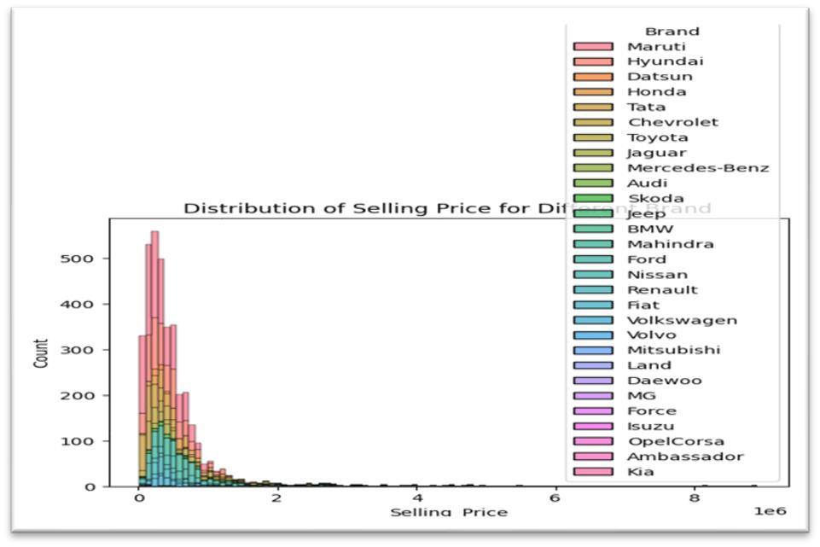
EDA Graphs.
The graphs below are made using matplotlib & Seaborn library (code in notebook file)
Count Plot Hist Plot
Count-plot showing the distribution of cars according to brand
Hist-plot to showcase the selling price of
various brands

Slide 9
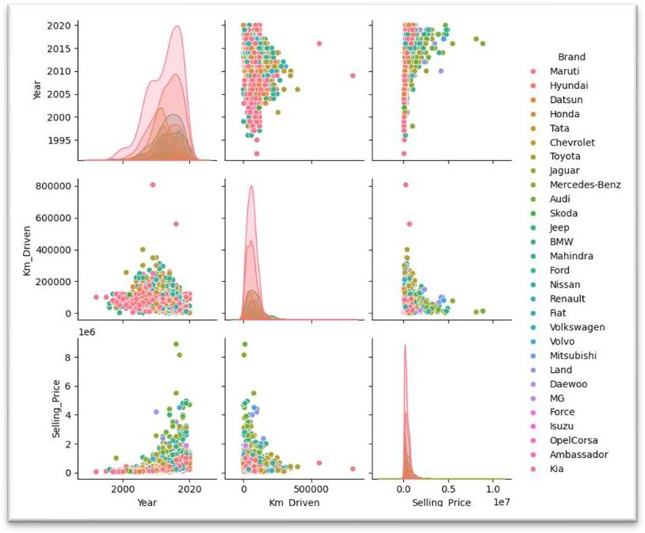
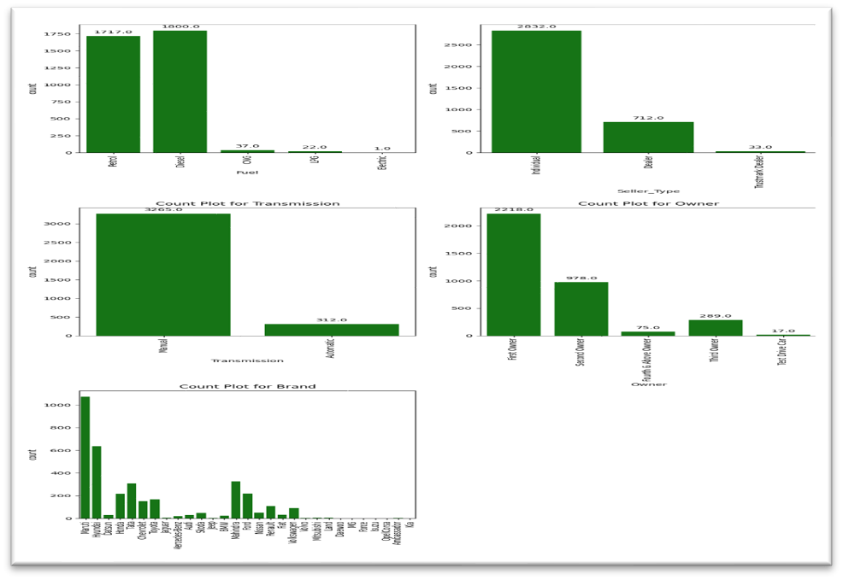
EDA Graphs.
Pair Plot (Numerical Data)
Count Plot (Categorical Data
Pair-plot showing the distribution of numerical data(selling price, km_driven, years) according to brand
Count Plot of various categorical data representation.

Slide 10
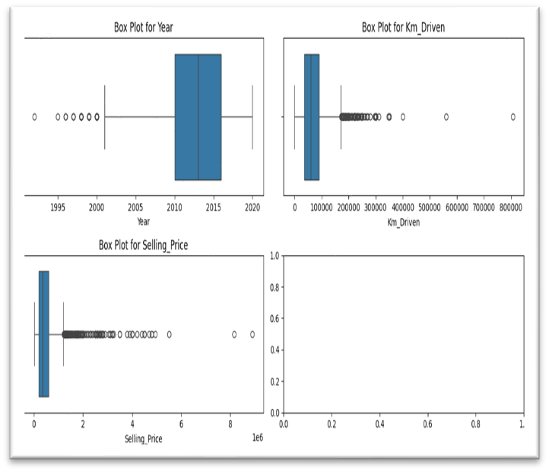
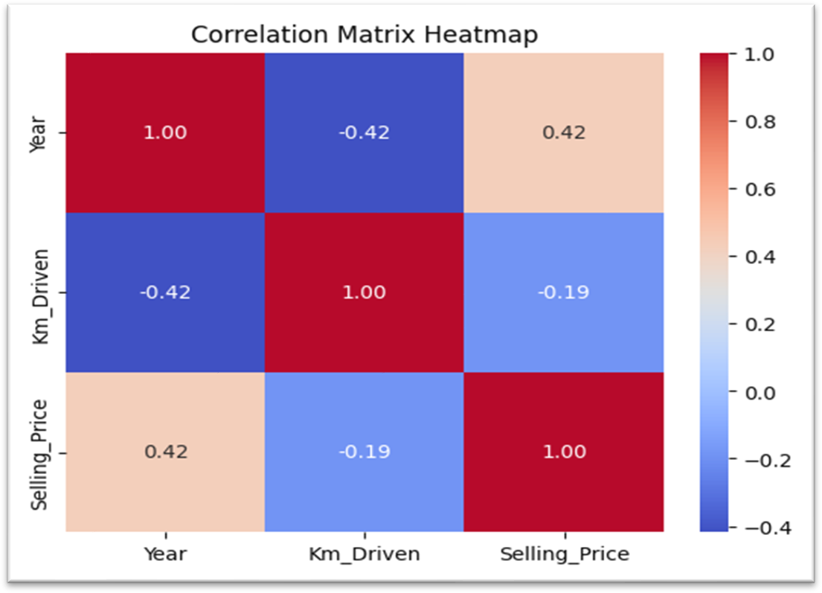
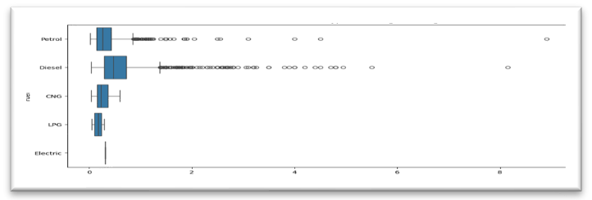
Graphical Analysis and conclusion on Data
Box Plot to find the Outlier data HeatMap to find the Correlation in Numerical
data

Slide 11
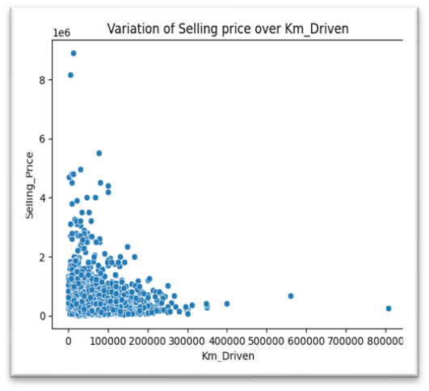
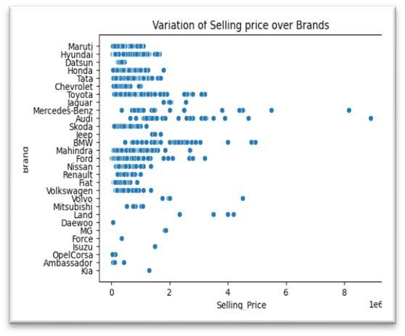
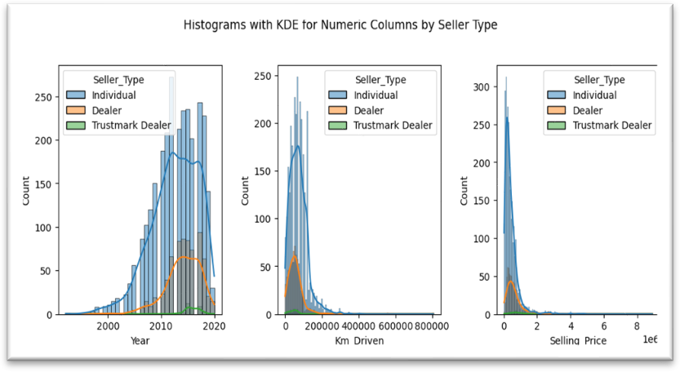
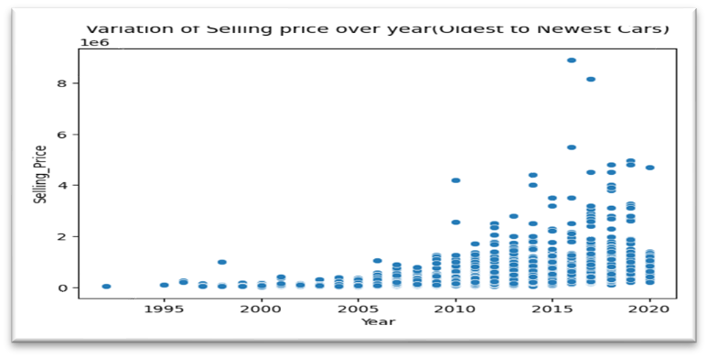
Graphical Analysis and conclusion on Data
Hist Plot on continuous data Scatter Plot of Selling price over km, brand & Year
The Histplot shows the distribution of continuous numerical.
The various Scatter plot shows the variation of selling
price indicating the impact of year(age), kms (use)
,brand (popularity) on the price of resale value of a car.

Slide 12
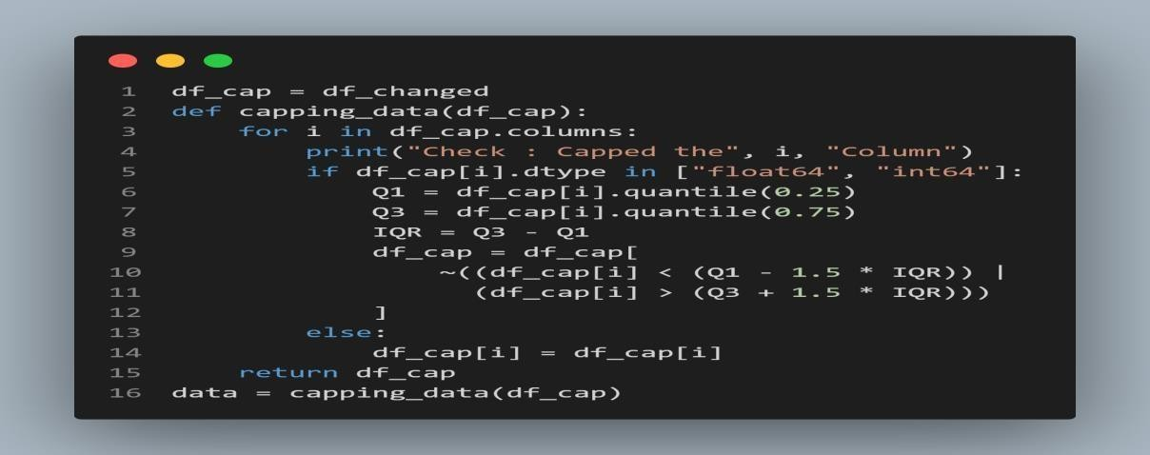
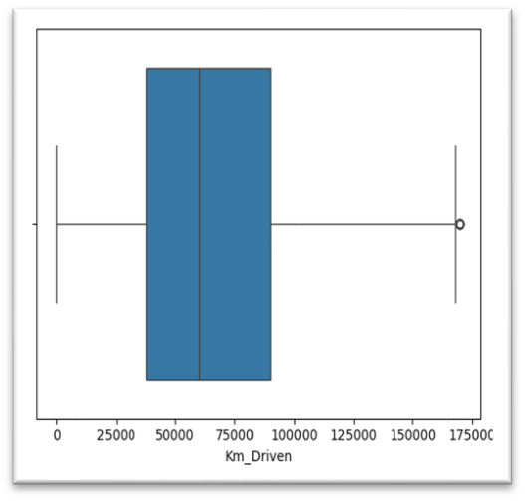
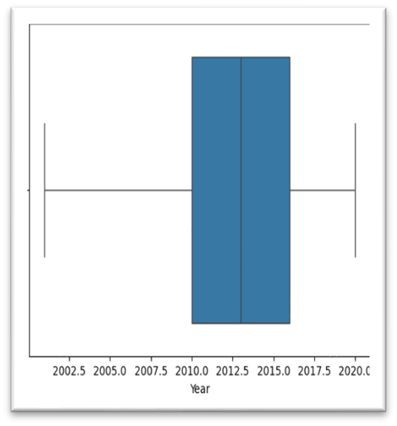
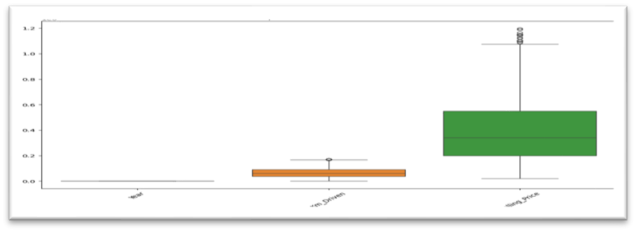
Data Cleaning & Pre-Processing Steps.
Few data cleaning steps are discussed in previous slides.
Treating Outliers (Data Capping) ScatterPlot (After Capping Data)
The above code caps the data value of numerical data columns using the IQR formulas.
The scatter plot on the right shows the capped effect on outlier.
Capping helps us to remove the data which may change the model prediction due to outlier data.

Slide 13
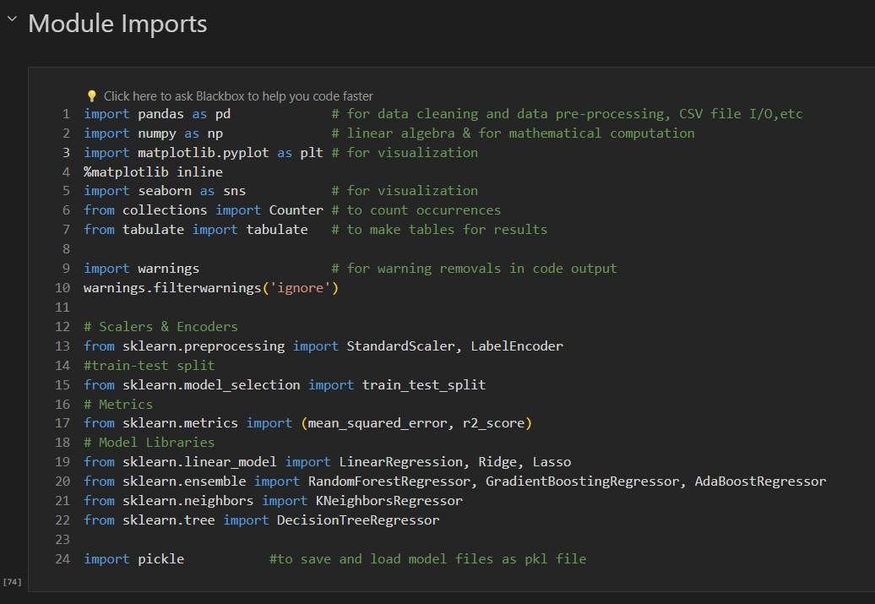
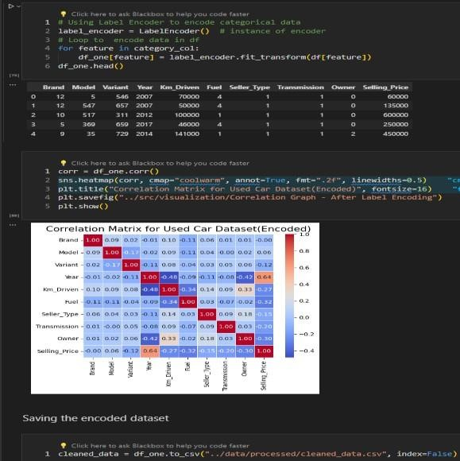
Data Cleaning & Pre-Processing Steps(In ML Model).
Step 1–Import Necessary Library and dataset Step 2 –Encoding dataset
Import the basic library for data handling & the model handling ones from sklearn library.
The next step is similar to previous to import the dataset but we will import the processed dataset instead of raw which we handled in previous steps in graphical analysis
To save the dataset in last file at end we did -
data.to_csv(“<file-path/file-name>.csv", index=False)
The above code encodes the loaded dataset using label encoder so that we can use the categorical values in model training as it needs number to build model.
The correlation matrix shows us that the new
encoded values are in numeric.

Slide 14
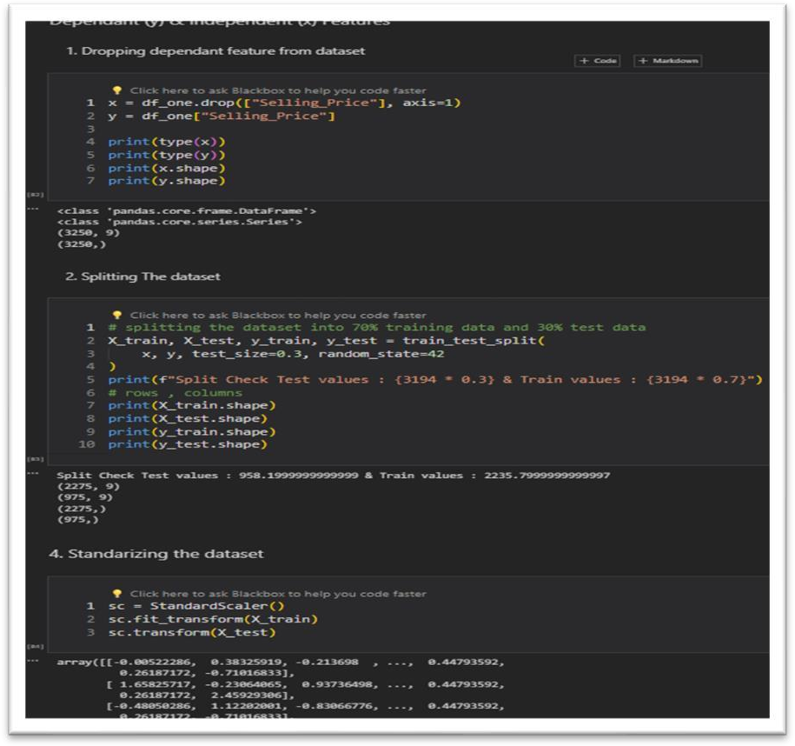
Data Cleaning & Pre-Processing Steps(In ML Model).
Step 3 –Splitting data into Dependant WIndependent variables for train-test split
The code shows us the basic step of model building where in we split the dataset into training data & testing data.
This step is very important as without doing the split if we train the model it will know the results and if unknown values are introduced it might not function as intended.
The practice of splitting data helps us to find various parameters such as accuracy, precision, recall values, r2 score, mse values etc which helps us to determine if our model is fit or not or should we tune it more or use some other modelling technique.
After these step we move on to actual
model building & selection step.

Slide 15
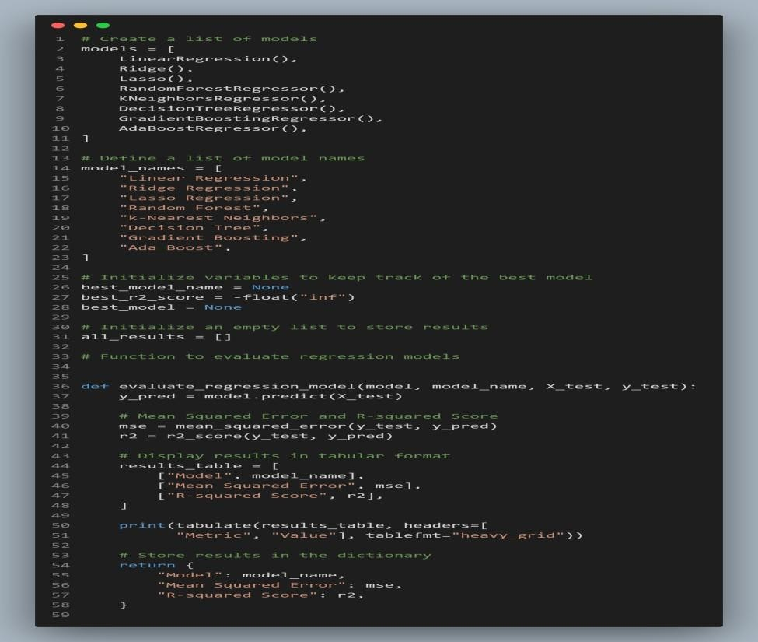
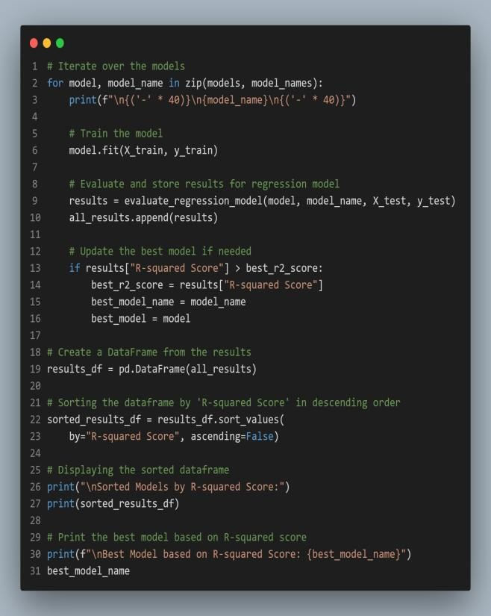
ML Modeling
I Will add the code in loop as writing the same piece of code repeatedly changing variable names and remembering them will be not good idea so instead I will do looping.

Slide 16
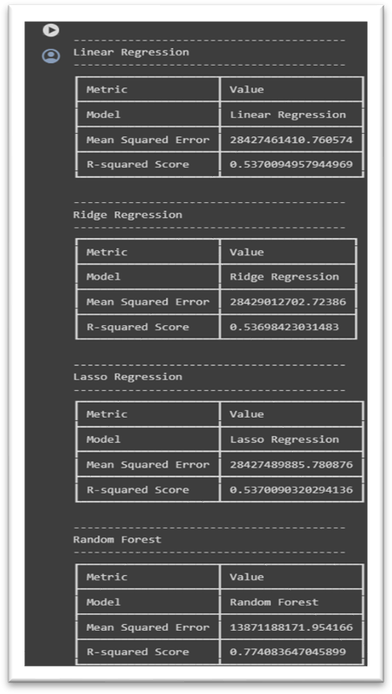
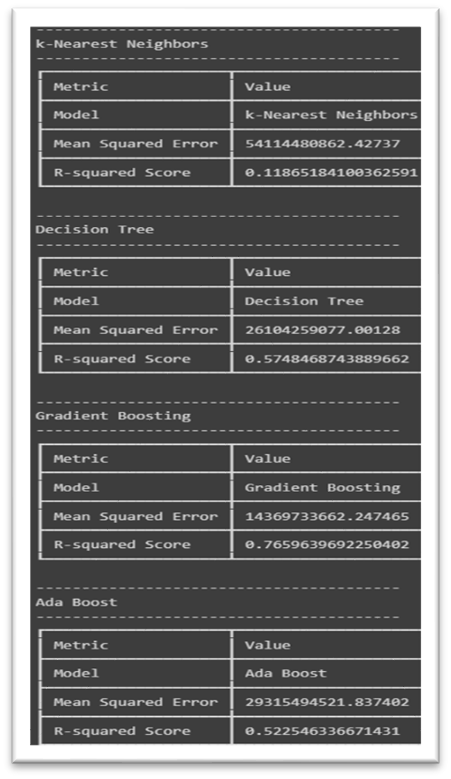
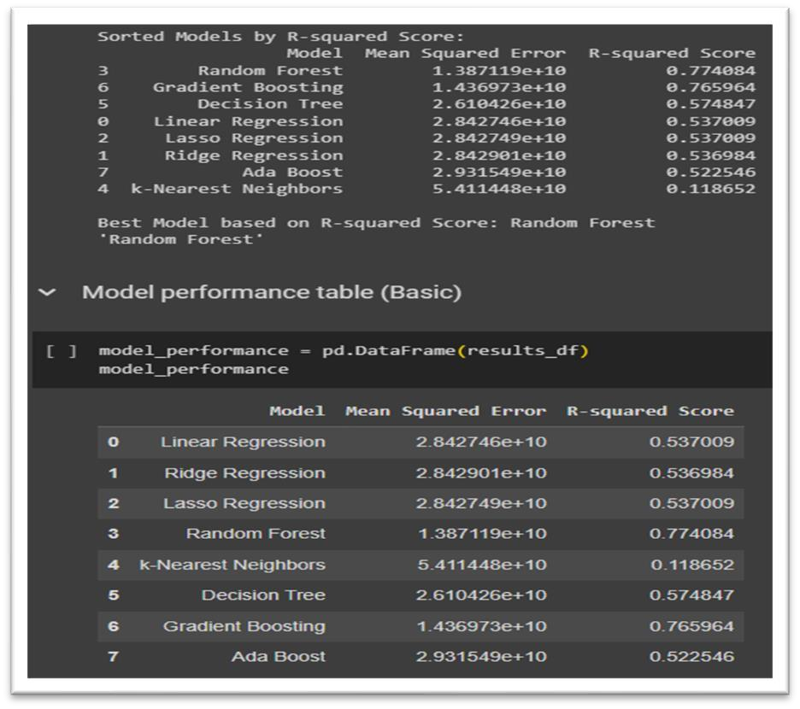
ML Modeling
In the previous slide we saw the code for model building – scoring ,parameters , function to check them on various passed models , save the results and iterate to next model. Here we see few glimpse of the code o/p.

Slide 17
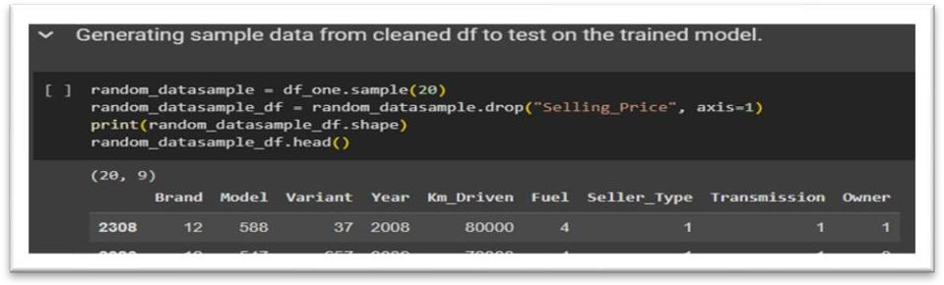
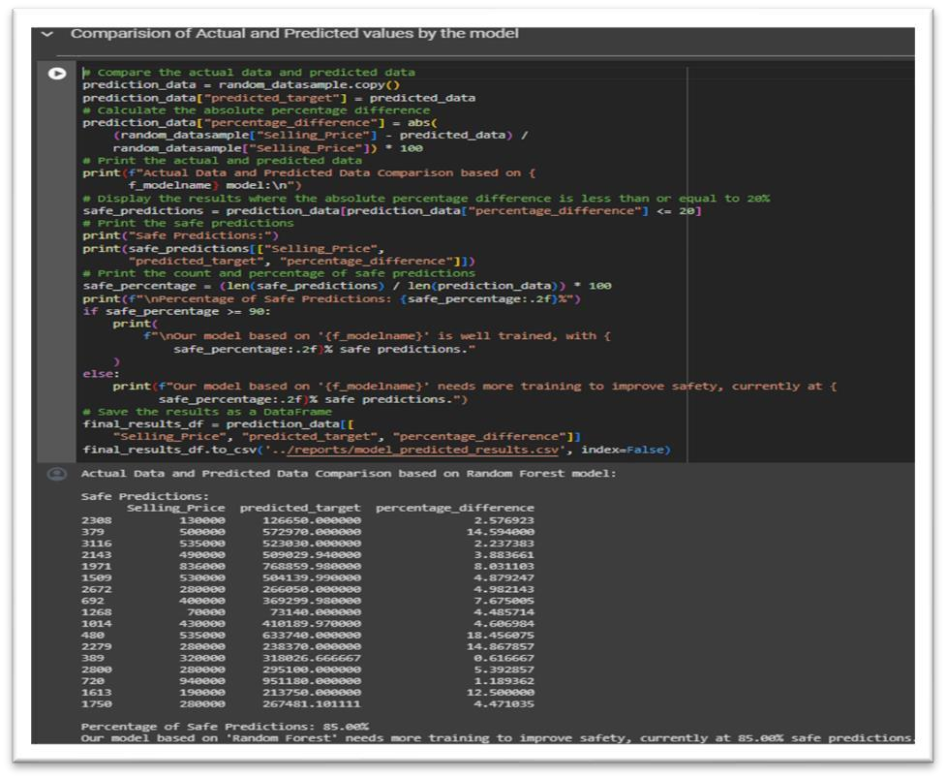
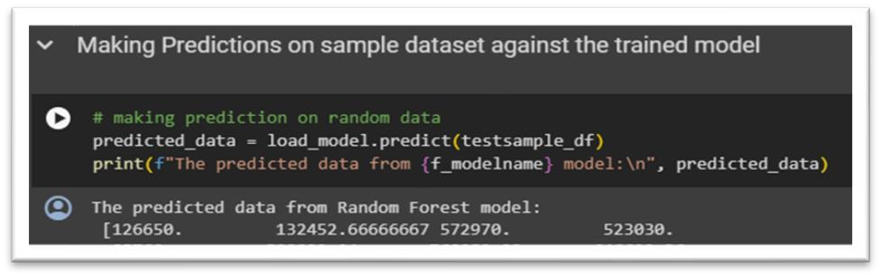
ML Modeling
In the previous slide we saw the model scores o/p and best model the next step is to save the model(will skip
ss can look into notebook) now we see the testing part of model against test data that we split.
The code above generates 20 random sample data from original file which we used for train test split and test them to predict value against model.
The code on side checks the actual value and predicted value ( I tweaked it a bit so that if difference of selling price is say under certain limit its safe prediction.

Slide 18
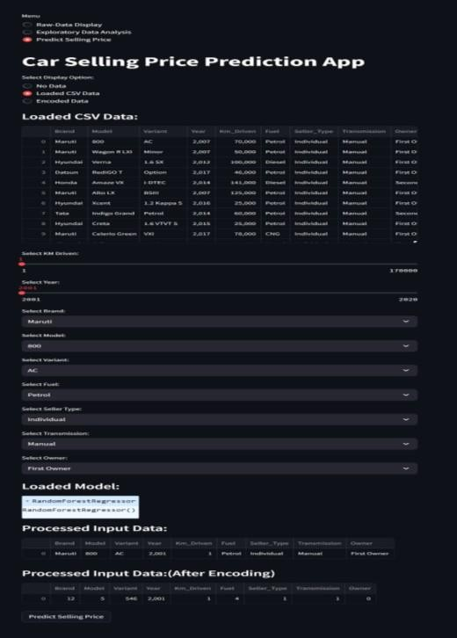
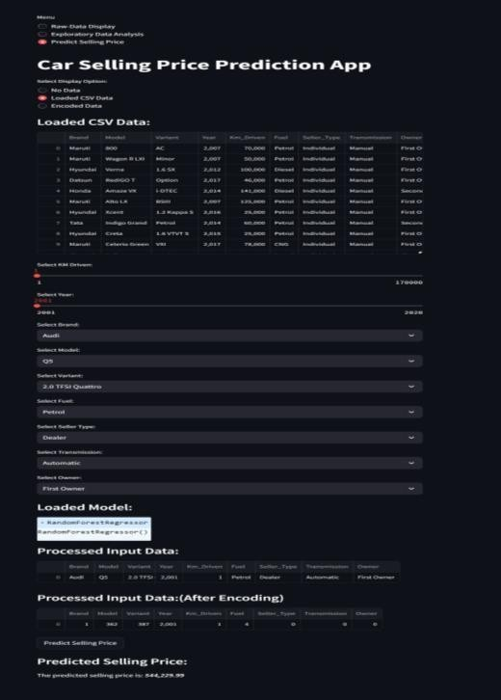
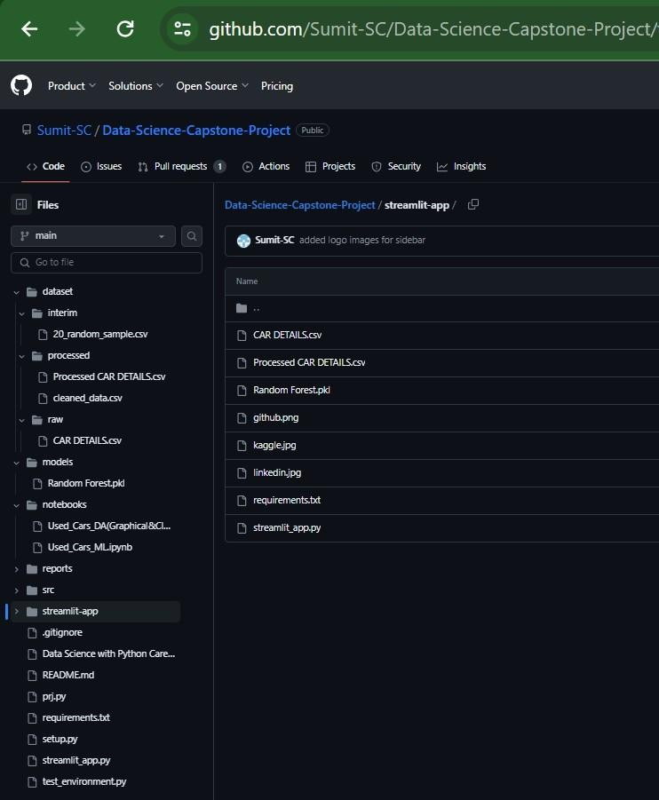
Deployment of ML Models using Streamlit.
Please visit the link to view the actual working code of the project (won’t paste long code)
Without any selection Prediction of Selling Price Github Code Structure

Slide 19
Endnotes
Reference Links:-
About Me :
Name – Sumit S.
Chaure
GitHub Repo Link
Streamlit App Weblink
Streamlit App Alternate
Google Drive Folder
Zip file
Google Colab Links (Run & View code Directly)
EDA & Graphical Analysis Colab
Model Training & Evaluation Colab
Readme File (To get the project structure & all links)
Batch – 10
Course – Data
Science With Python
GitHub - Sumit-SC
Kaggle – Sumit
Email - @

Slide 20
Endnotes
Reference Links:-
Github :- https://github.com/managerprovide/Capstone-Project.git
Google Drive :- https://drive.google.com/drive/folders/1t-UnbQily9BQ6tF-2qTkpZ9kF9kYcJd5?usp=drive_link
Streamlit App :- .Capstone-Project_streamlit_app.py
About me:
Name: Sakshi Pramod Kothavade
Course :- Data Science With Python
Email :- 15.sakshi.k@gmail.com

Slide 21

END

